Slide 1
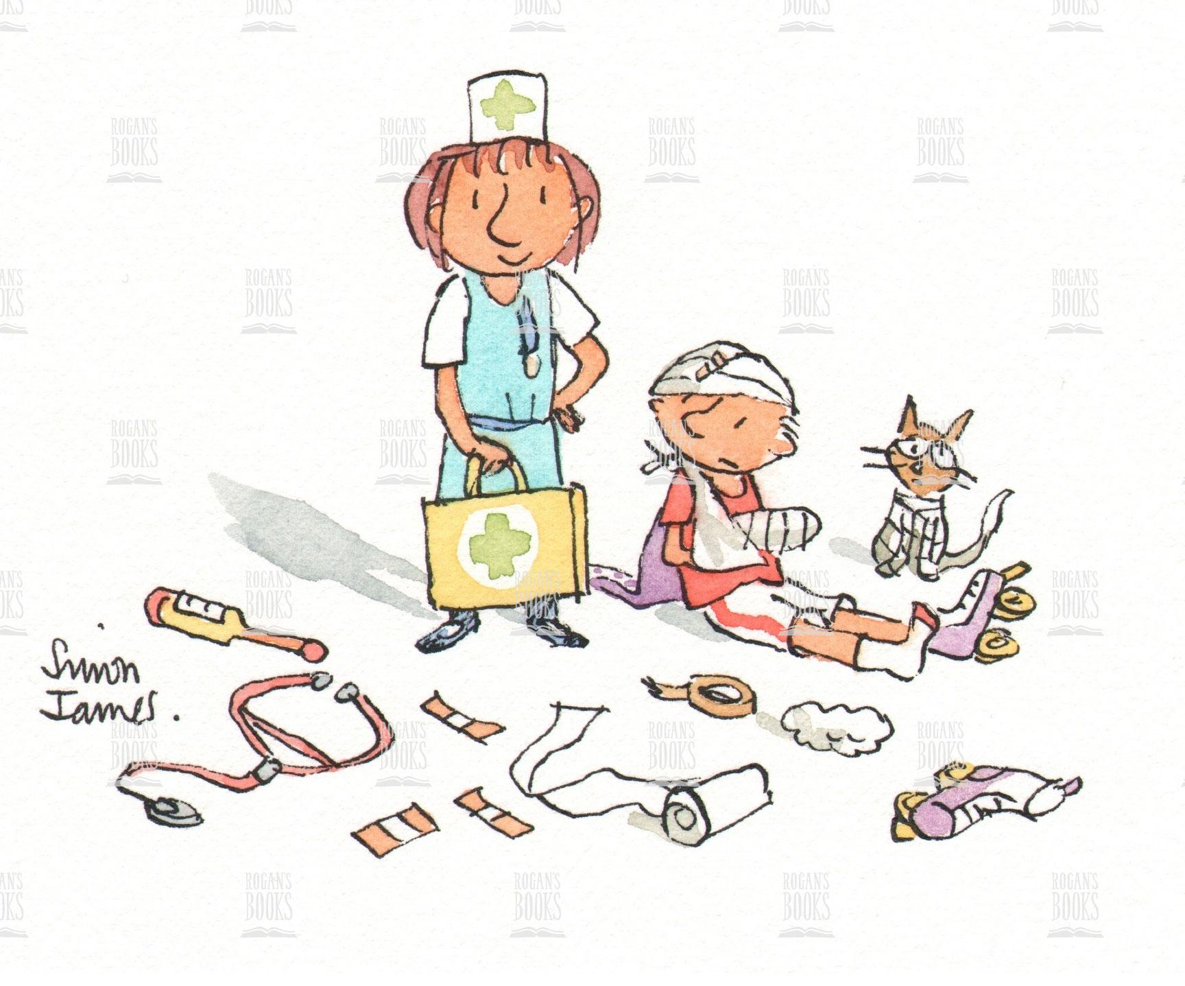
Welcome to Simon James

Slide 2
Simon James
Year 1

Slide 3
Meet the team!
Miss Mooney – teacher
Mrs T Jarvis – teaching assistant
Mrs K Jarvis – teaching assistant
Mrs Haine – PPA cover

Slide 4
The School Day
08:30 – 08:50 – School begins (Early morning learning time)
08:50 – 09:00 - Registration
09:00 – 10:45 – RWI Spellings and English
10:45 – 11:00 – Break
11:00 – 12:00 - Maths
12:00 – 13:00 – Lunch
13:00 – 15:00 – Afternoon sessions
15:00 – 15:15 – Whole class story
15:15 – School ends

Slide 5
Balancing Support and Challenge
Our aim throughout the school is to ensure that the children are given the support they need to become independent, inspired learners with aspirations for the future.
To achieve this we ensure that every child receives:
High quality teaching from all members of staff
Immediate in-class intervention
Pre teaching
Additional, short term, small group intervention
Teaching from specialists
Extra curricular opportunities

Slide 6
As part of our commitment to continually improving standards and attainment for all children, we have fully embedded the Read, Write, Inc. Phonics programme to boost standards in writing, grammar and spelling.
Read Write Inc is a method of learning centred around letter sounds and phonics, and we use it to aid children in their reading and writing.
Reading opens the door to learning. The more a child learns, the more he or she will want to find out.
Using Read Write Inc, children learn to read effortlessly so that they can put all their energy into comprehending what they read. It also allows them to spell effortlessly so that they can put all their energy into composing what they write.

Slide 7
Rewards and Sanctions...
We will be utilising the ClassDojo behaviour management system this year.
Familiar to the children
Accessible for all adults at all times
Engaging
Open communication between school and home
Allows us to track every child and highlights when they may be struggling.
Parental logins will be available when we return in September.

Slide 8
Phonics Screening Check
Every Year 1 child in the country will be taking the phonics screening check in the same week in June.
The aim of the check is to ensure that all children are able to read by the end of year two.
This ‘midpoint check’ will ensure that we have a clear understanding of what the children need to learn in year 2.

Slide 9
What happens during the check?
The check is very similar to what the children already do during phonics lessons. Children will be asked to ‘sound out’ a word and blend the sounds together.eg d-o-g – dog
The test contains 40 words and each child will sit one to one and read each word aloud to Miss Heaton.
The check will take approximately 10 minutes per child; although all children are different and will complete the check at their own pace.
The list of the words the children read is a combination of 20 real words and 20 nonsense words.

Slide 10
Home Learning...
Home Learning is compulsory.
Reading Spelling Maths
Details of this will follow in September.

Slide 11
Home Learning - spellings
Every child will take home 5 spellings every night (Monday – Thursday). They should work with you at home to practise using the Look, Cover, Write, Check method (LCWC).
Every day, the children will be tested on the spellings from the previous day. Every Monday, the children will be tested on 5 spellings from the previous week.
The spelling lists are altered to your child’s ability and come from the Year 2 National Curriculum word lists that the children are expected to know by the end of the year.

Slide 12
What can you do to support your child?

Slide 13
Reading...
Sit comfortably and limit distractions.
Before reading, discuss the cover or illustrations – what might the story be about?
When listening, don’t rush to correct mistakes unless it significantly alters meaning.
Characterisation – put on voices to make them come to life.
After reading discuss what has been read. Ask questions about events, characters and predict what might happen next.
Ask your child to make comparisons within the book and with other books
Always praise and comment on progress.
Read to them yourself and communicate your own enjoyment.
Read with a dictionary to support reading as writers.
Model being a reader yourself.

Slide 14
Writing...
Encourage children to write at home:
Film reviews
Stories
Instructions
Biographies
Diaries
Newspaper articles
Poetry

Slide 15
Maths...
We will ensure that your child is taught the Key Stage 1 curriculum, however we have found that it is very effective if the following areas are supported at home:
.
.
Year 1 | Year 2
Count in 2s, 5s and 10s | Know 2, 5 and 10 times tables Count in 3s
Time: O’clock Half past Quarter past and to | Time: To the nearest 5 minutes
Money: Recognising coins Making amounts | Money: Making amounts Giving change
Reasoning: Big emphasis on explaining understanding. How do you know that 2 + 2 = 4?

Slide 16
Useful Information...
PE Kit
White top
Royal blue shorts
White socks
Plimsolls
Snack
A piece of fruit is provided every day; however you may wish to provide an additional small, healthy snack.

Slide 17
Contact us!
We are always here to answer any queries or help you with any concerns as best we can. If you would like to contact us please use the following avenues:
Reading record Books or note in reading folders
Message us via Class Dojos
Email
smooney@holycross.plymouth.sch.uk
Arrange a meeting with the office

