Slide 1
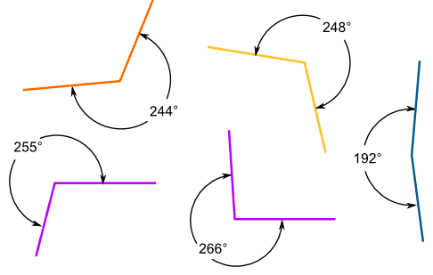
Calculating angles

Slide 2
Today we will:
Find missing angles between intersecting lines.
Find missing angles in triangles
Find missing angles in quadrilaterals.

Slide 3
Missing angles on a straight line
Remember:
Angles on a straight line add up to 180°
To calculate a missing angle on a straight line, take away the known angle from 180°
Eg:
180° - 65°=
115°
180° - 35°=
145°
180° - 80°=
100°

Slide 4
missing angles in a full turn
Remember:
Angles in a full turn add up to 360°
To calculate a missing angle in a full turn, take away the known angle from 360°
Eg:
360° - 70°=
290°
360° - 45°=
315°

Slide 5
missing angles on intersecting lines
Remember:
All 4 angles will add up to 360°
Opposite angles on a cross are equal
Eg:
Step 1: Opposite angle is equal
Step 2: 65° + 65° = 130°
360° - 130° = 230°
Step 3: 230° ÷ 2 = 115°

Slide 6
Missing angles within turns
Straight lines
180° - known angles
Full turns
360° - known angles
Intersecting lines
Opposite angles are equal
You should now be able to complete questions 1-6 without a protractor.

Slide 7
Missing angles in triangles
Remember
All angles in a triangle add up to 180°
To find the missing angle, add the known angles and subtract from 180°
65° + 75° = 140°
180° - 140° = 40°
80° + 45° = 125°
180° - 125° = 55°

Slide 8
Missing angles in quadrilaterals
Remember
A quadrilateral is any shape with 4 straight sides
E.g. square, rhombus, rectangle, trapezium, parallelogram
The angles in a quadrilateral add up to 360°
90° + 90° + 40° = 220°
360° - 220° = 140°

Slide 9
Calculating missing angles
180°
Angles on a straight line add up to 180°
Angles in a triangle add up to 180°
360°
Angles in a full turn add up to 360°
Angles in a quadrilateral add up to 360°
Intersecting Lines
Opposite angles are equal
The angles add up to 360°
You should now be able to complete all questions.

