Slide 1





ANGLES IN TRIANGLES
SELECT A WORKSHEET:
© 2018 Maths4Everyone.com

Slide 2
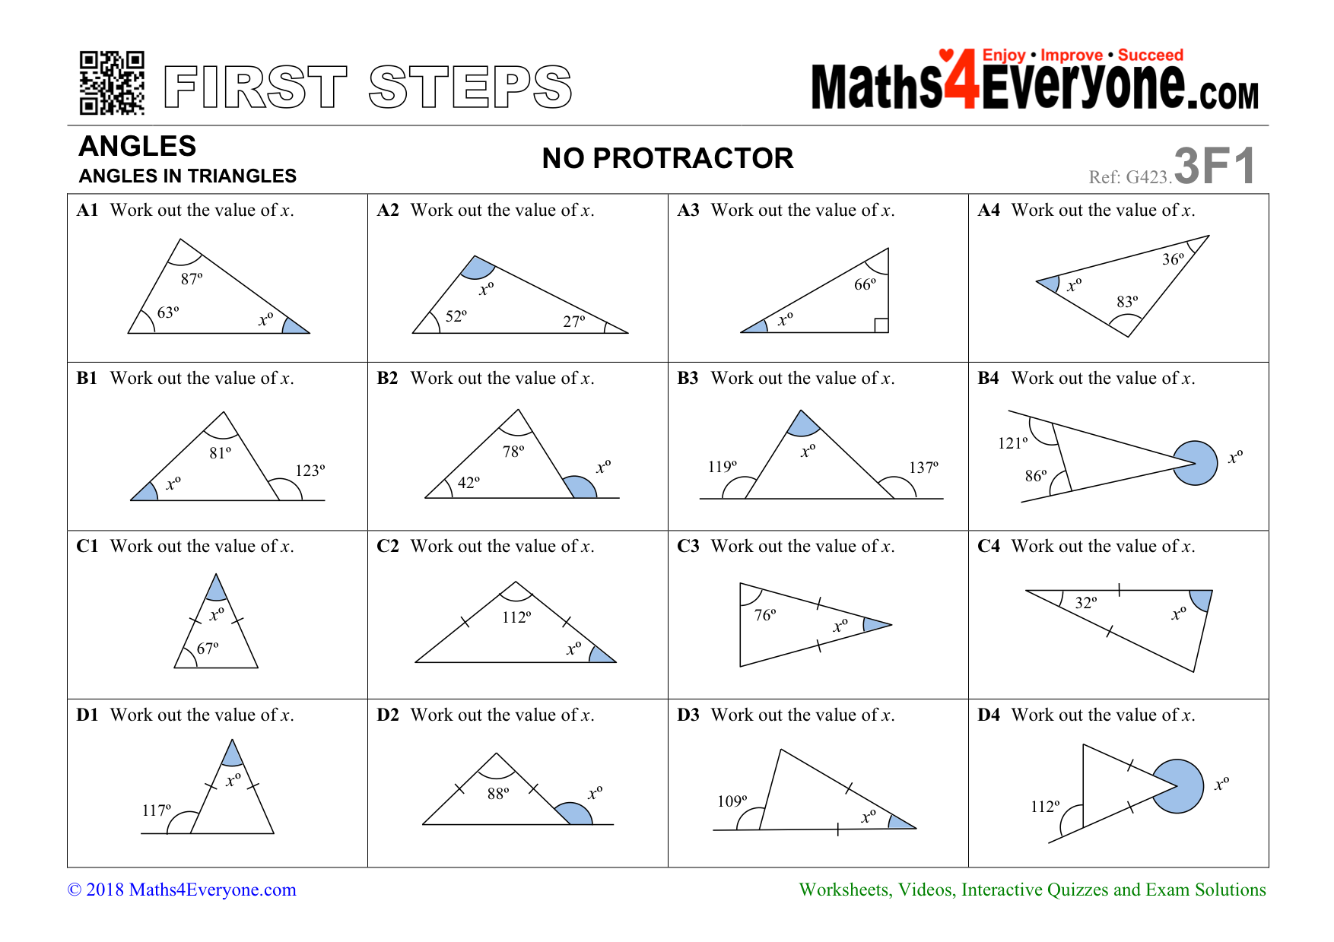
First Steps
CLICK A QUESTION TO ENLARGE, OR PRESS ‘ESC’ ON YOUR KEYBOARD TO FINISH

Slide 3
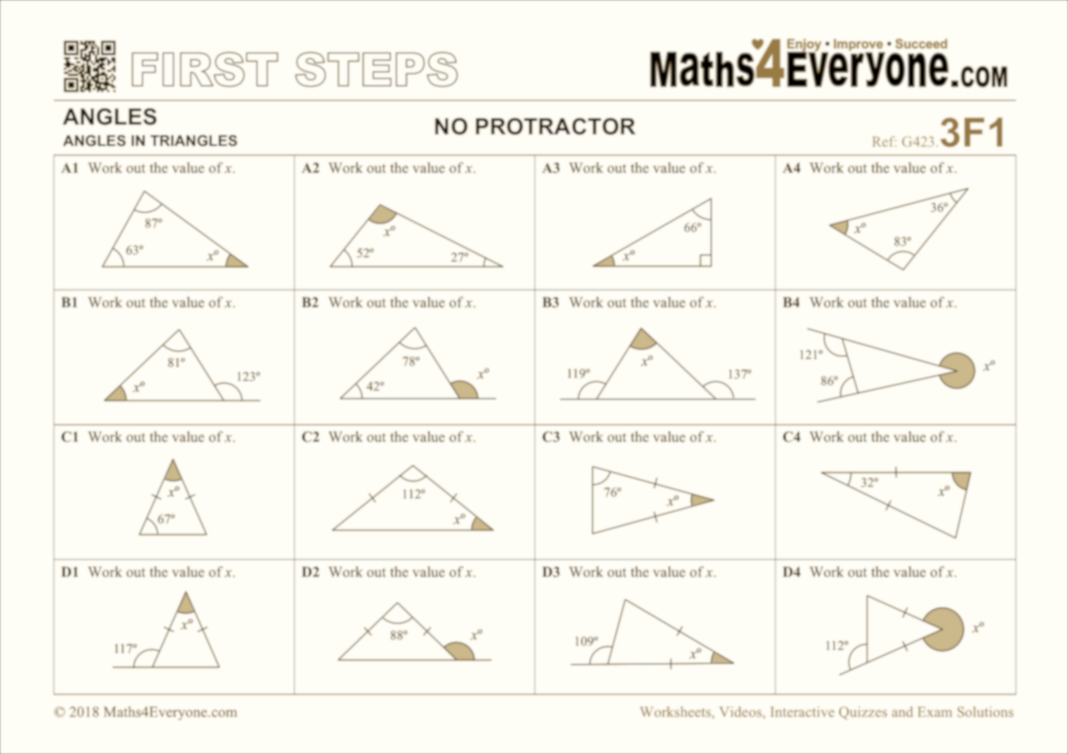
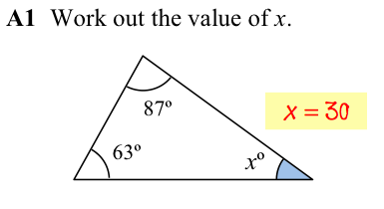
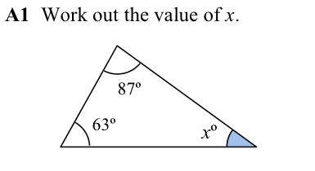
A1
X
CLICK TO TOGGLE BETWEEN QUESTION AND ANSWER

Slide 4
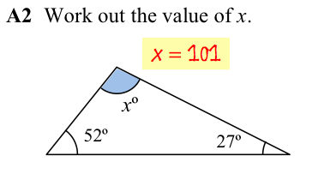
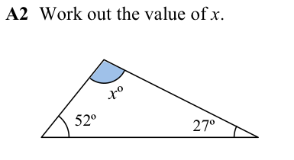
A2
X
CLICK TO TOGGLE BETWEEN QUESTION AND ANSWER

Slide 5
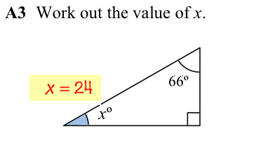
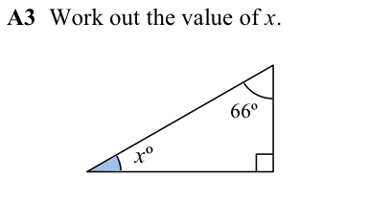
A3
X
CLICK TO TOGGLE BETWEEN QUESTION AND ANSWER

Slide 6
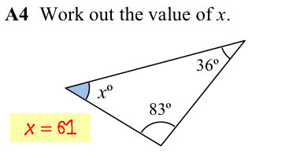
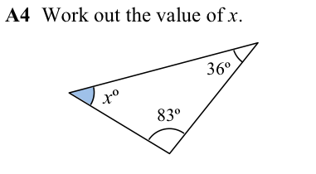
A4
X
CLICK TO TOGGLE BETWEEN QUESTION AND ANSWER

Slide 7
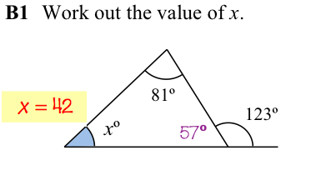
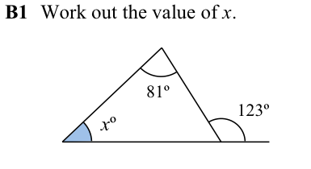
B1
A4
X
CLICK TO TOGGLE BETWEEN QUESTION AND ANSWER

Slide 8
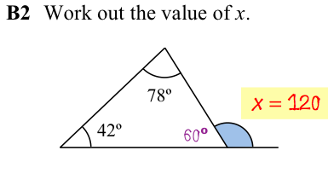
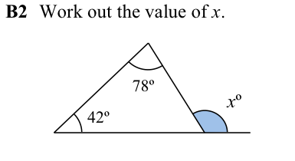
B2
A4
X
CLICK TO TOGGLE BETWEEN QUESTION AND ANSWER

Slide 9
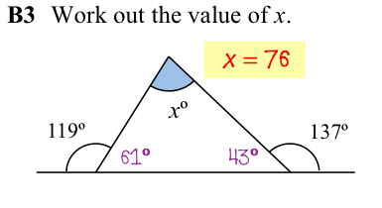
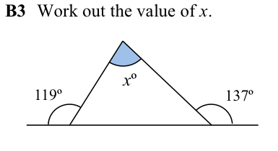
B3
A4
X
CLICK TO TOGGLE BETWEEN QUESTION AND ANSWER

Slide 10
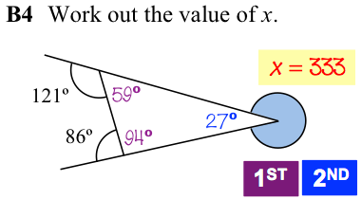
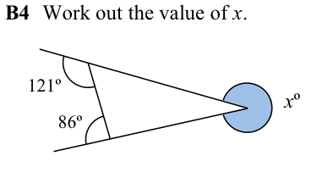
B4
A4
X
CLICK TO TOGGLE BETWEEN QUESTION AND ANSWER

Slide 11
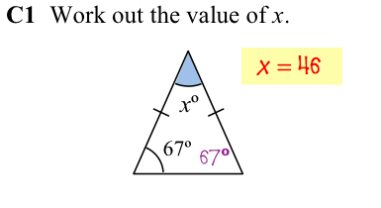
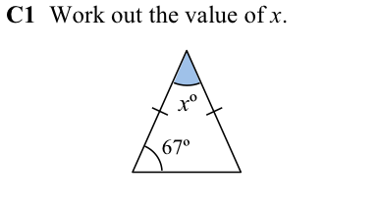
C1
A4
X
CLICK TO TOGGLE BETWEEN QUESTION AND ANSWER

Slide 12
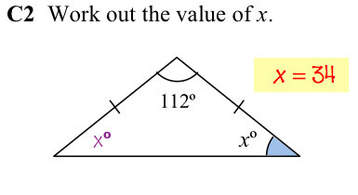
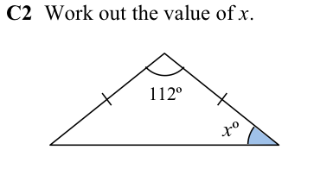
C2
A4
X
CLICK TO TOGGLE BETWEEN QUESTION AND ANSWER

Slide 13
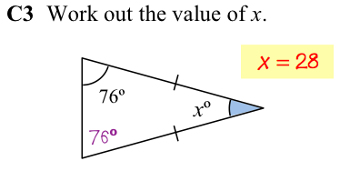
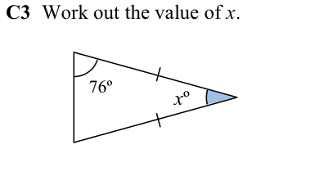
C3
A4
X
CLICK TO TOGGLE BETWEEN QUESTION AND ANSWER

Slide 14
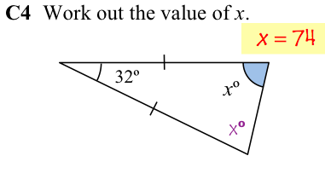
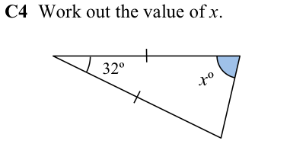
C4
A4
X
CLICK TO TOGGLE BETWEEN QUESTION AND ANSWER

Slide 15
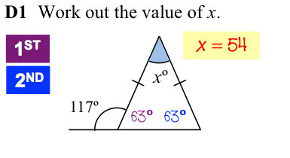
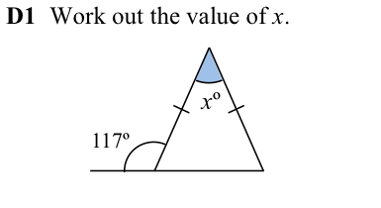
D1
A4
X
CLICK TO TOGGLE BETWEEN QUESTION AND ANSWER

Slide 16
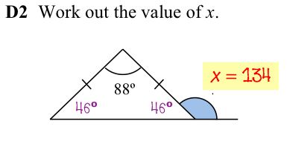
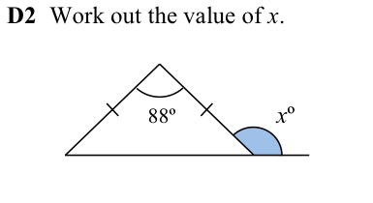
D2
A4
X
CLICK TO TOGGLE BETWEEN QUESTION AND ANSWER

Slide 17
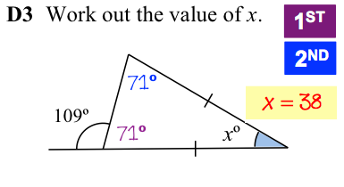
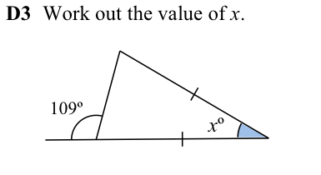
D3
A4
X
CLICK TO TOGGLE BETWEEN QUESTION AND ANSWER

Slide 18
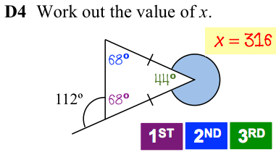
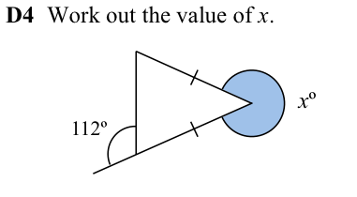
D4
A4
X
CLICK TO TOGGLE BETWEEN QUESTION AND ANSWER

Slide 19
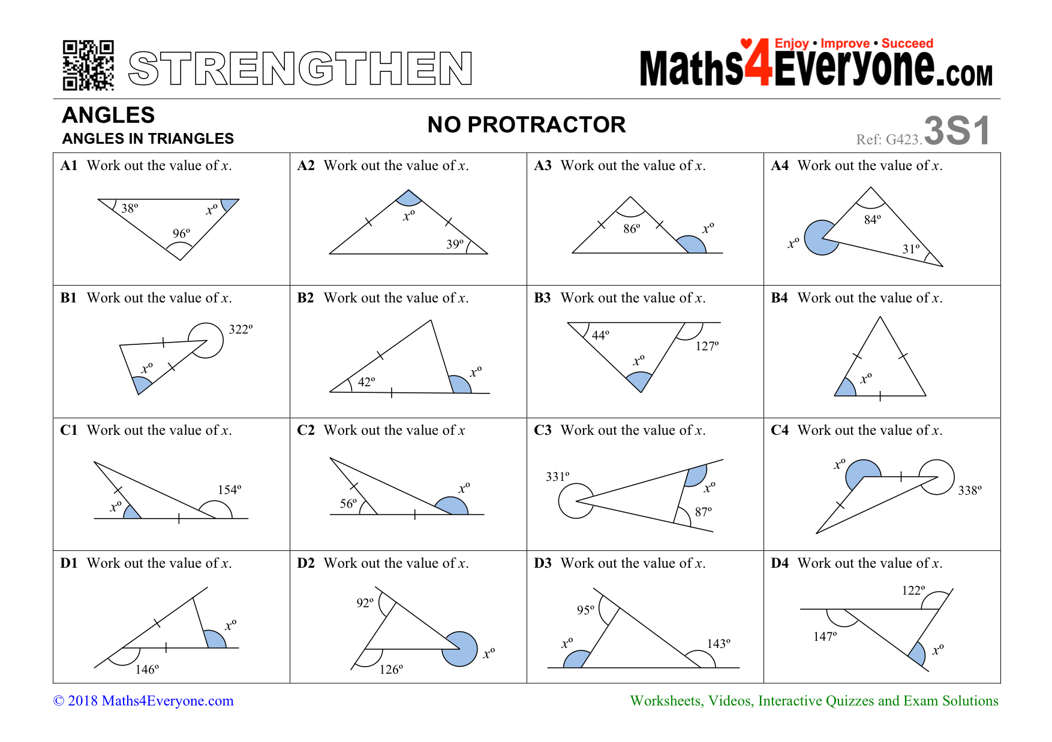
Strengthen
CLICK A QUESTION TO ENLARGE, OR PRESS ‘ESC’ ON YOUR KEYBOARD TO FINISH

Slide 20
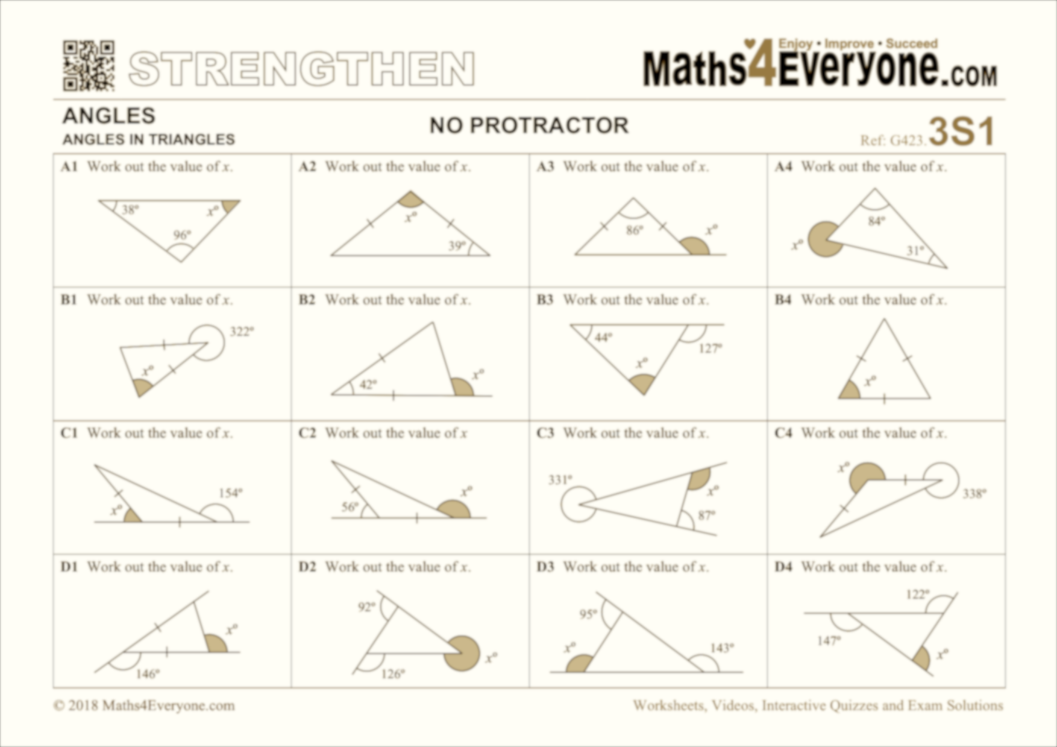
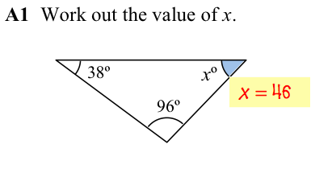
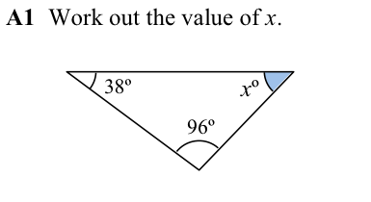
A1
X
CLICK TO TOGGLE BETWEEN QUESTION AND ANSWER

Slide 21
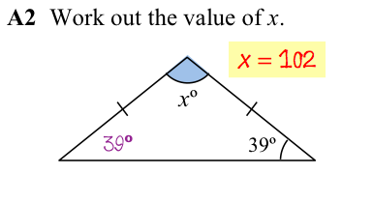
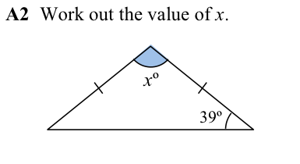
A2
X
CLICK TO TOGGLE BETWEEN QUESTION AND ANSWER

Slide 22
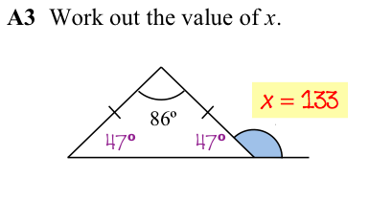
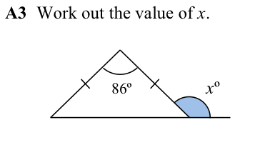
A3
X
CLICK TO TOGGLE BETWEEN QUESTION AND ANSWER

Slide 23
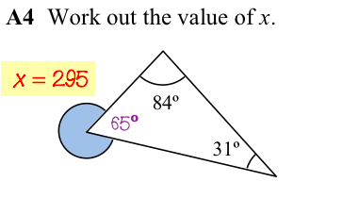
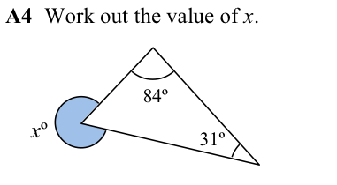
A4
X
CLICK TO TOGGLE BETWEEN QUESTION AND ANSWER

Slide 24
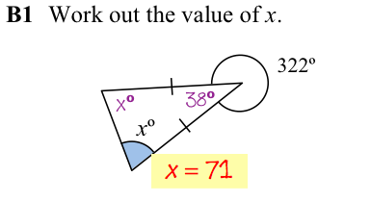
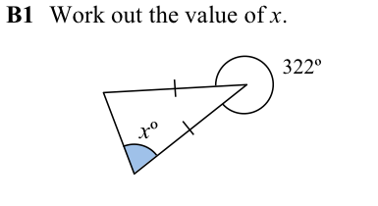
B1
A4
X
CLICK TO TOGGLE BETWEEN QUESTION AND ANSWER

Slide 25
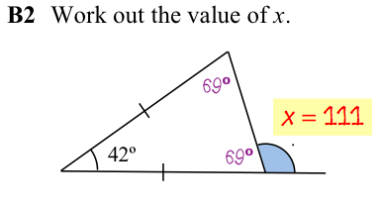
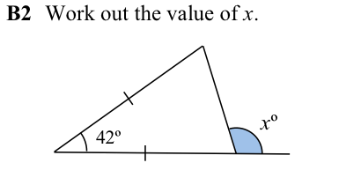
B2
A4
X
CLICK TO TOGGLE BETWEEN QUESTION AND ANSWER

Slide 26
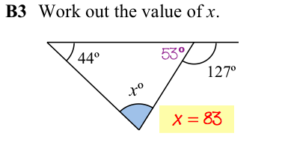
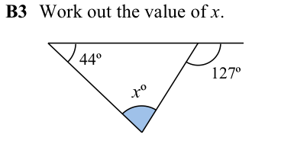
B3
A4
X
CLICK TO TOGGLE BETWEEN QUESTION AND ANSWER

Slide 27


B4
A4
X
CLICK TO TOGGLE BETWEEN QUESTION AND ANSWER

Slide 28


C1
A4
X
CLICK TO TOGGLE BETWEEN QUESTION AND ANSWER

Slide 29


C2
A4
X
CLICK TO TOGGLE BETWEEN QUESTION AND ANSWER

Slide 30


C3
A4
X
CLICK TO TOGGLE BETWEEN QUESTION AND ANSWER

Slide 31


C4
A4
X
CLICK TO TOGGLE BETWEEN QUESTION AND ANSWER

Slide 32


D1
A4
X
CLICK TO TOGGLE BETWEEN QUESTION AND ANSWER

Slide 33


D2
A4
X
CLICK TO TOGGLE BETWEEN QUESTION AND ANSWER

Slide 34


D3
A4
X
CLICK TO TOGGLE BETWEEN QUESTION AND ANSWER

Slide 35


D4
A4
X
CLICK TO TOGGLE BETWEEN QUESTION AND ANSWER

Slide 36

Extend
CLICK A QUESTION TO ENLARGE, OR PRESS ‘ESC’ ON YOUR KEYBOARD TO FINISH

Slide 37



A1
X
CLICK TO TOGGLE BETWEEN QUESTION AND ANSWER

Slide 38


A2
X
CLICK TO TOGGLE BETWEEN QUESTION AND ANSWER

Slide 39


A3
X
CLICK TO TOGGLE BETWEEN QUESTION AND ANSWER

Slide 40


A4
X
CLICK TO TOGGLE BETWEEN QUESTION AND ANSWER

Slide 41


B1
A4
X
CLICK TO TOGGLE BETWEEN QUESTION AND ANSWER

Slide 42


B2
A4
X
CLICK TO TOGGLE BETWEEN QUESTION AND ANSWER

Slide 43


B3
A4
X
CLICK TO TOGGLE BETWEEN QUESTION AND ANSWER

Slide 44


B4
A4
X
CLICK TO TOGGLE BETWEEN QUESTION AND ANSWER

Slide 45


C1
A4
X
CLICK TO TOGGLE BETWEEN QUESTION AND ANSWER

Slide 46


C2
A4
X
CLICK TO TOGGLE BETWEEN QUESTION AND ANSWER

Slide 47


C3
A4
X
CLICK TO TOGGLE BETWEEN QUESTION AND ANSWER

Slide 48

C4
A4
X
CLICK TO TOGGLE BETWEEN QUESTION AND ANSWER

Slide 49
D1
A4

Slide 50
D2
A4

Slide 51
D3
A4

Slide 52
D4
A4

