Slide 1
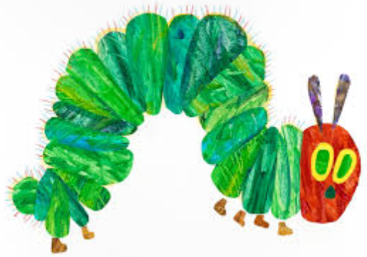
Welcome to Eric Carle

Slide 2
Eric Carle
Year 1/2

Slide 3
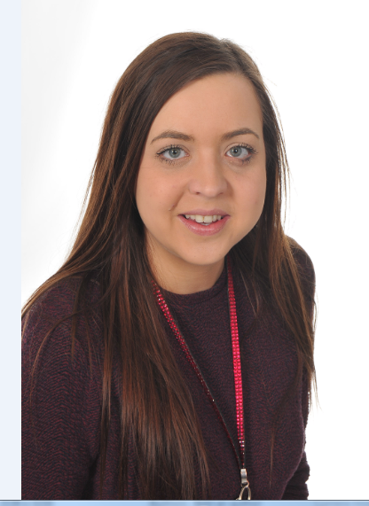
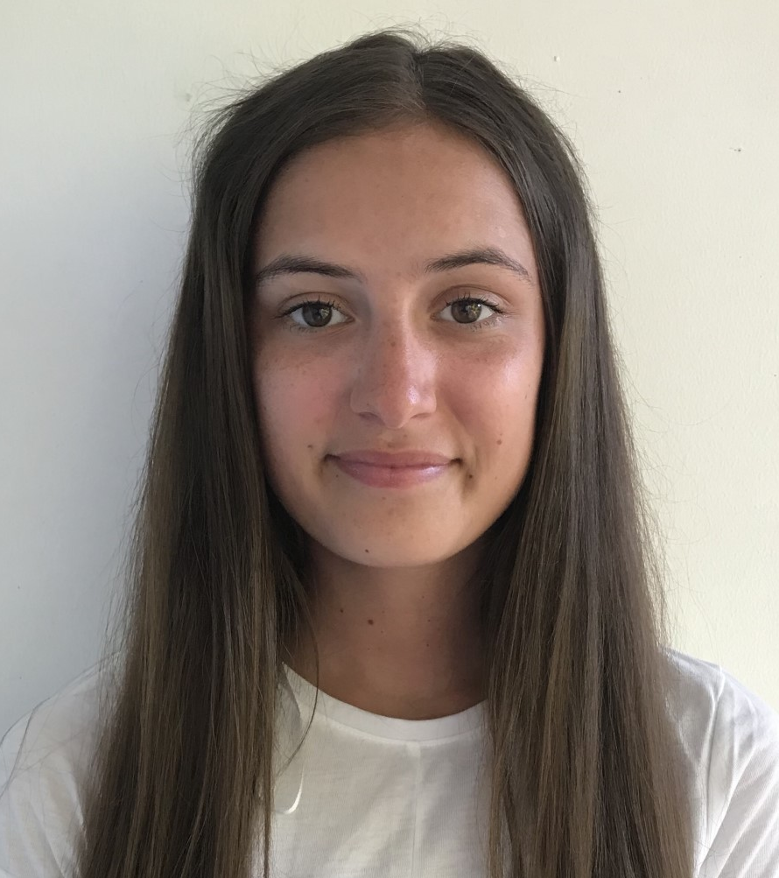
Meet the team!
Miss Heaton Miss Goddard

Slide 4
School Priorities
Maths will continue to look at how to improve children’s fluency and we will introduce a new resource called Power Maths to ensure progression and coverage;
Our curriculum will be a major piece of work as we design something for Plymouth CAST schools but also to make clear the breadth and balance that clearly shows intent, implementation and impact;
Develop our Global Learning Classroom;
Greater PE and Sports promotion/participation;
Greater depth in writing;
Increasing our involvement and impact on our local community

Slide 5
The School Day
08:30 – 08:50 – School begins (Early morning learning time)
08:50 – 09:00 - Registration
09:00 – 10:45 – RWI and English
10:45 – 11:00 – Break
11:00 – 11:50 - Maths
11:50 – 12:40 – Lunch
12:40 - 13:00- Meditation/ ERIC
13:00 – 15:00 – Afternoon sessions
15:00 – 15:15 – Whole class story
15:15 – School ends

Slide 6
Phonics Screening Check
Every Year 1 child in the country will be taking the phonics screening check in the same week in June.
The aim of the check is to ensure that all children are able to read by the end of year two.
This ‘midpoint check’ will ensure that we have a clear understanding of what the children need to learn in year 2.

Slide 7
What happens during the check?
The check is very similar to what the children already do during phonics lessons. Children will be asked to ‘sound out’ a word and blend the sounds together.eg d-o-g – dog
The test contains 40 words and each child will sit one to one and read each word aloud to Miss Heaton.
The check will take approximately 10 minutes per child; although all children are different and will complete the check at their own pace.
The list of the words the children read is a combination of 20 real words and 20 nonsense words.

Slide 8
End of Key Stage Assessments...
Assessment is an integral part of teaching. The children are assessed in a variety of ways on a daily basis. In addition to this, our year 2 children will sit a range of tests in June next year. These will be administered as unobtrusively as possible. It is important to us that no child is put under any undue stress.
The tests consist of:
2 reading papers
2 maths (Reasoning and Arithmetic)
1 spelling
1 grammar
Writing is assessed throughout the year through a series of independent writes.

Slide 9
Rewards and Sanctions...
We will be utilising the ClassDojo behaviour management system this year.
Familiar to the children
Accessible for all adults at all times
Engaging
Open communication between school and home
Allows us to track every child and highlights when they may be struggling.

Slide 10
Home Learning...
Home Learning is compulsory.
Reading Spelling Maths

Slide 11
What can you do to support your child?

Slide 12
Reading...
Sit comfortably and limit distractions.
Before reading, discuss the cover or illustrations – what might the story be about?
When listening, don’t rush to correct mistakes unless it significantly alters meaning.
Characterisation – put on voices to make them come to life.
After reading discuss what has been read. Ask questions about events, characters and predict what might happen next.
Ask your child to make comparisons within the book and with other books
Always praise and comment on progress.
Read to them yourself and communicate your own enjoyment.
Read with a dictionary to support reading as writers.
Model being a reader yourself.

Slide 13
Writing...
Encourage children to write at home:
Film reviews
Stories
Instructions
Biographies
Diaries
Newspaper articles
Poetry

Slide 14
Maths...
We will ensure that your child is taught the Key Stage 1 curriculum, however we have found that it is very effective if the following areas are supported at home:
.
.
Year 1 | Year 2
Count in 2s, 5s and 10s | Know 2, 5 and 10 times tables Count in 3s
Time: O’clock Half past Quarter past and to | Time: To the nearest 5 minutes
Money: Recognising coins Making amounts | Money: Making amounts in different ways Giving change
Reasoning: Big emphasis on explaining understanding and reasoning. How do you know that 2 + 2 = 4? If I count in 5s, will I say 18? Why not?

Slide 15
Useful Information...
PE Kit
White top
Royal blue shorts
White socks
Plimsolls
Snack
A piece of fruit is provided every day; however you may wish to provide an additional small, healthy snack.

Slide 16
Contact us!
We are always here to answer any queries or help you with any concerns as best we can. If you would like to contact us please use the following avenues:
Reading record Books or note in reading folders
Message us via Class Dojos
email
sheaton@holycross.plymouth.sch.uk
ggoddard@holycross.plymouth.sch.uk
Arrange a meeting with the office

